Slide 1
266 Natural Language Processing
Week 7: Question Answering and Summarization

Slide 2
This Week
Goals
Understand similarities between question answering and summarization
Understand how data structure can affect approach to task
Modern techniques…

Slide 3
Peeking Ahead
Week 1: Introduction
Week 2: Text Classification
Week 3: Language and Context
Week 4: Pretrained Transformers
Week 5: Text Generation Models
Week 6: Machine Translation PROJECT PROPOSAL PAST DUE Feb 18
Week 7: Question Answering & Summarization
Week 8: Linguistic Representation
Week 9: Entities and Linking
Week 10: Embedding-based Retrieval
Week 11: Multimodality in NLP
Week 12: ML Fairness and Privacy
Week 13: NLP in the Real World

Slide 4
Announcements
Assignment 3 (Various) - released this past Friday 02/16
Due on Sunday 03/03 (Tuesday 03/05 if you use late days)
Assignment 4 (MM) to be released Friday 03/08
Project Proposals - Past Due (02/18)!
Feedback in process (assume you can start working)
Questions?
Concerns?

Slide 5
Announcements
Paper reading sessions:
Songs Across Borders: Singable and Controllable Neural Lyric Translation
Natalie: Wednesday 02/28 5:30 PST
WebGLM: Towards An Efficient Web-Enhanced Question Answering System with Human Preferences
Jennifer: Monday 03/04 5:30 PST
Notebook walkthrough sessions:
TBD
Concerns?

Slide 6
The Plan
Structure of Class
Key Learning Review
Framing Questions
Extractive vs. Abstractive?
Faithfulness, Fluency, and Coherence
Architectures
Extractive and abstractive
Data Sets and Approaches
Evaluation
New approaches to Fine-Tuning

Slide 7
Key Learnings Review
Question Answering & Summarization

Slide 8
NLP Review
How does self-attention work in a transformer?
What is the role of an encoder in a seq2seq architecture?
What are some language modeling tasks (e.g. tasks used to create language models)?
What kind of architecture is used in neural machine translation?

Slide 9
Key Framing Questions
Question Answering & Summarization

Slide 10
Why Summarization AND QA Together?
Both take implicit or explicit query and try to provide response.
Implicit Question: What is the most salient/relevant content?
Explicit Question: What is the jellyfish life cycle?
Implicit Answer: Abridged version of input
Explicit Answer: Actual answer to the question

Slide 11
Extractive vs. Abstractive
What makes the task extractive?
What makes the task abstractive?

Slide 12
Extractive vs. Abstractive
What makes the task extractive?
Find content within content
What makes the task abstractive?
Generate content based on content
Can we combine them into a hybrid?

Slide 13
Faithfulness + Fluidity + (Coherence)
Faithfulness
+
What is faithfulness?
What is fluidity?
What is coherence?
In which quadrant are extractive systems?
(II and I)
In which quadrant are abstractive systems?
(IV and I)
When does coherence become an issue?
(Multiple sentences)
II
I
Fluidity
+
III
IV

Slide 14
Translation vs. Summarization
Comparisons with a related task:
In what sense are Translation and Summarization similar?
In what sense are Translation and Summarization different?
What may that mean for the metrics?
Notes:
Both generate language that must be faithful to the input. Translation is currently sentence based but Summarization requires much larger input.

Slide 15
Approaches & Architectures
Question Answering & Summarization

Slide 16
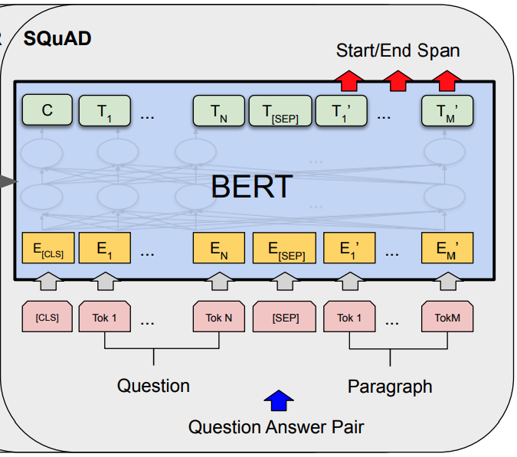
Using Transformers: Extractive Architectures
Why Only Encoders Required?
Identify spans in context
Phrases or Sentences
Emit scores?
Implicit or Explicit
How can we leverage BERT tokens to identify spans?
Source: Devlin et al., 2018

Slide 17
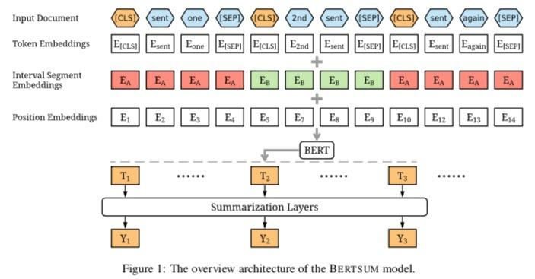
BERT and Extractive Summarization
E_{C}
CLS vector for each sentence
Learn score for each sentence in fine-tuning
Pick top 3 sentences with trigram blocking
Source: Fine-tune BERT for Extractive Summarization
Notes:
Source: Fine-tune BERT for Extractive Summarization

Slide 18
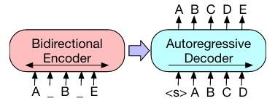
Abstractive Architectures
Encoders and Decoders
Need to understand input
Question and/or Article
Need to produce new text
Responsive to Q or article
Which systems incorporate this architecture?
Source: https://arxiv.org/pdf/1910.13461.pdf

Slide 19
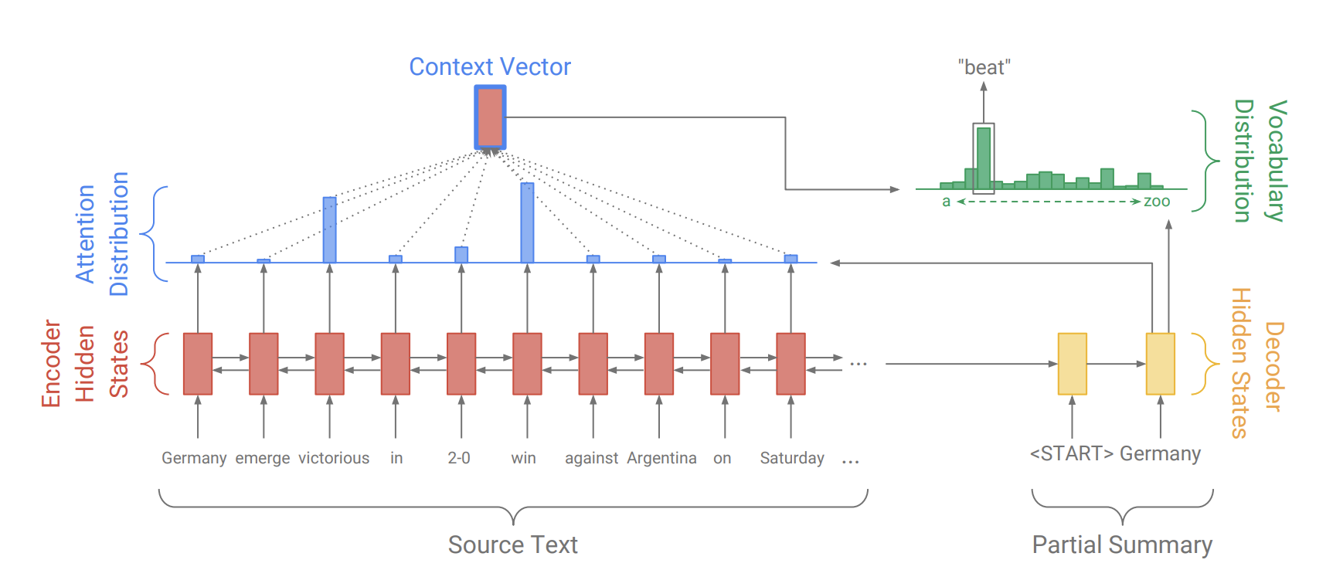
A Very Insightful LSTM-Based Model
Train of thought:
LSTM-based Seq2Seq models are a logical approach to generate abstractive summarizations, but ...
Source: Get To The Point: Summarization with Pointer-Generator Networks

Slide 20
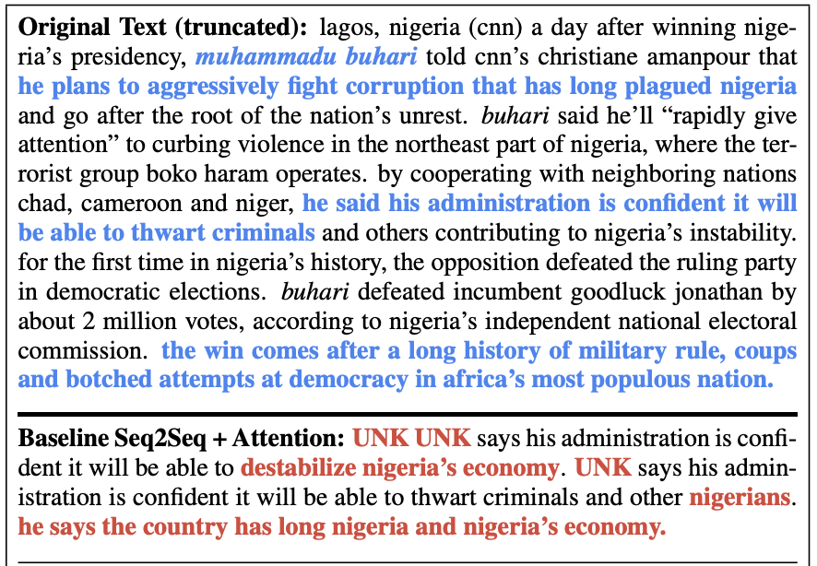
A Very Insightful LSTM-Based Model
Train of thought:
LSTM-based Seq2Seq models are a logical approach to generate abstractive summarizations, but ...
…Two key issues:
They easily ‘make stuff up’
Lots of unknown tokens… even if the correct word is ‘right there’!
Source: Get To The Point: Summarization with Pointer-Generator Networks

Slide 21
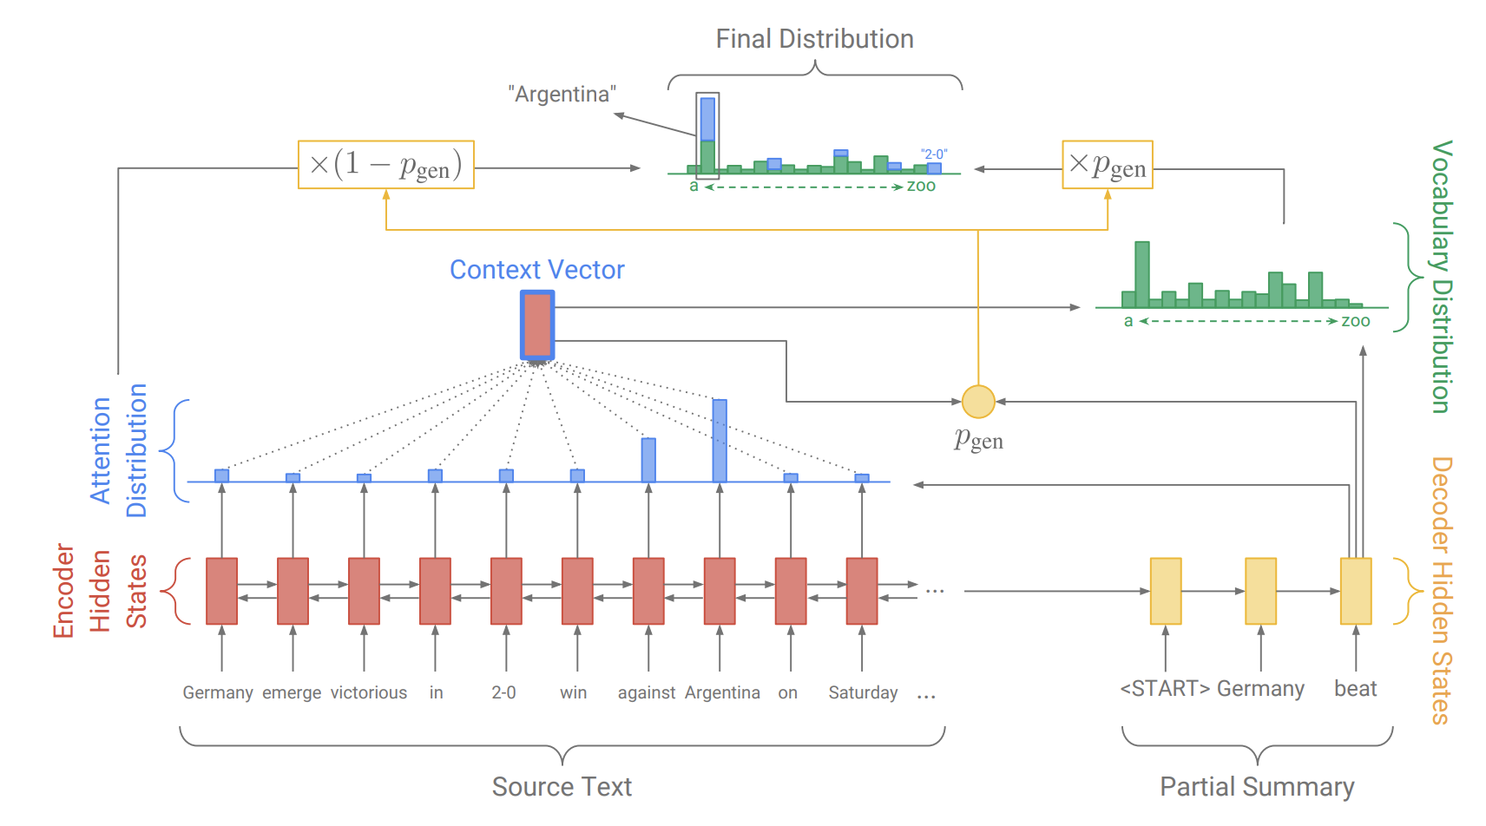
A Very Insightful LSTM-Based Model
What could be the logic here? How could this architecture help?
What else could be done? (Hint: cost function modification?)
Source: Get To The Point: Summarization with Pointer-Generator Networks

Slide 22
Data Helps Define the Approach
Question Answering & Summarization

Slide 23
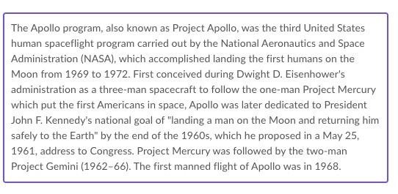
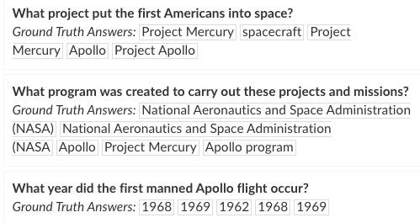
QA Data Defines the Approach I
SQUAD
Extract these answers from this text based on these questions.
How does this structure the inputs to our model?
Source: https://rajpurkar.github.io/SQuAD-explorer/explore/1.1/dev/Apollo_program.html
Notes:
We need to feed our model the context paragraph and the question and teach it to extract the answer from the context.

Slide 24
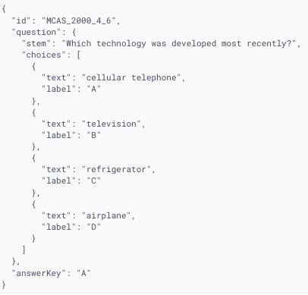
QA Data Defines the Approach II
AI2 Reasoning Challenge (ARC)
7787 grade school test questions
Easy Set and Challenge Set
Multiple choice format
14 million background sentences
Some success with large decoder only language models and prompt completion approach.
How would we structure a prompt for this type of multiple choice question?
Source: https://allenai.org/data/arc

Slide 25
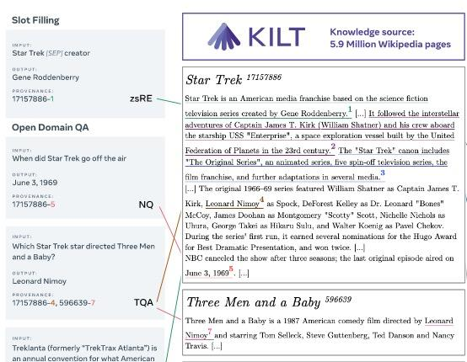
QA Data Defines the Approach III
Knowledge Intensive Language Tasks
Curated set of inputs, outputs, provenance
Covers multiple tasks:
Fact Checking
Entity Linking
Open Domain QA
What is open domain long form QA?
How can we use this data to develop open domain long form QA systems?
Source: https://arxiv.org/pdf/2009.02252.pdf

Slide 26
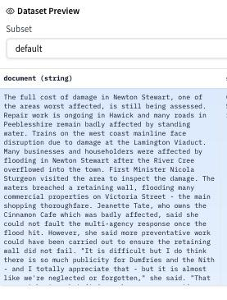

Summarization Data Defines the Approach I
XSum
Extreme Summarization (XSum)
Given this entire article generate a one sentence summary
Extractive or abstractive?
Source: https://huggingface.co/datasets/xsum

Slide 27
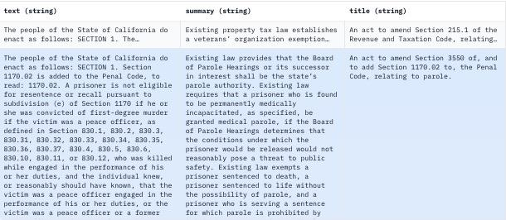
Summarization Data Defines the Approach II
BillSum
Summarize US Congressional and CA State bills
1000 to 2000 character length summaries
Human generated
Many summaries repeat text from bill
Extractive or Abstractive?
Single doc or multi doc summarization?
Truncate the input?
Sources: https://huggingface.co/datasets/billsum
https://arxiv.org/pdf/1910.00523.pdf
Notes:
https://github.com/FiscalNote/BillSum

Slide 28
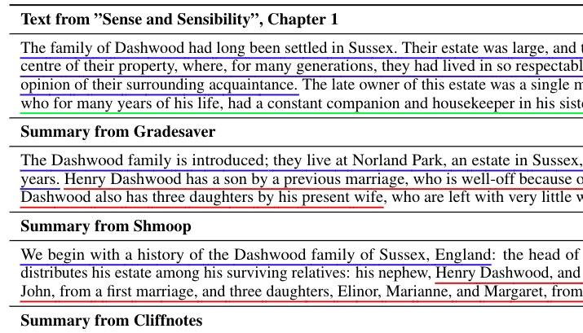
Summarization Data Defines the Approach III
BookSum
Summarize 405 novels, plays, stories
Paragraph, chapter, and book summaries for each
Multiple reference summaries per item
Paragraph + paragraph = chapter?
Extractive or Abstractive?
Single doc or multi doc summarization?
Roll up the outputs?
Sources: https://huggingface.co/datasets/kmfoda/booksum
https://arxiv.org/pdf/2105.08209.pdf
Notes:
https://github.com/salesforce/booksum

Slide 29
Evaluation
Question Answering & Summarization

Slide 30
Evaluation Metrics for Summarization
Reference (14 words)
“Rangers say midfielder Joey Barton ‘will return to full-time training’ following a club-imposed suspension”
Candidate (16 words)
“Rangers midfielder Joey Barton is to return to full-time training after being suspended by the club”
ROUGE (recall-based)
ROUGE-1
How many of the words in the reference occur in the candidate?
ROUGE-2
How many of the bigrams in the reference occur in the candidate?
ROUGE-L
What is the longest sequence in the reference that occurs in the candidate?
ROUGE-S
How many of the skipgrams in the reference occur in the candidate?

Slide 31
How do you count in ROUGE?
Reference (14 words)
“Rangers say midfielder Joey Barton ‘will return to full-time training’ following a club-imposed suspension”
Candidate (16 words)
“Rangers midfielder Joey Barton is to return to full-time training after being suspended by the club”
 | Reference words in candidate | Candidate words in reference | Precision | Recall | F1
ROUGE-1 (unigrams) | 8/14 | 8/16 | 0.50 | 0.57 | 0.53
ROUGE-2 (bigrams) | 5/14 | 5/16 | 0.31 | 0.35 | 0.33
ROUGE-L Rangers—midfielder Joey Barton—return to full-time training
ROUGE-S skipgrams | Rangers say Rangers midfielder Rangers Joey... say midfielder say Joey say Barton...
Notes:
Candidate contains “great”
Reference contains “good” or “very good” or “fantastic”

Slide 32
ROUGE
How well does ROUGE capture faithfulness?
How well does ROUGE capture fluidity?
How well does ROUGE capture coherence?

Slide 33
Which Evaluation Metric?
Metric | Match Unit | Measures | Uses
BLEU | word/n-gram | word overlap | Translation
ROUGE | word/sequence | Word overlap | Summarization
BLEURT | Doc is scored | ?? | Generation with scores
BERTScore | Word Embeddings | Pairwise embedding similarity | Compare word sequences
USE/Sentence Transformers | Sequence Embeddings | Embedding similarity | Compare sequences
LLM Embeddings | Sequence Embeddings | Embedding similarity | Compare sequences

Slide 34
Notebook Walkthrough
Question Answering & Summarization

Slide 35
Training: Domain Adaptation
Question Answering & Summarization

Slide 36
Domain Adaptation Options:
Supervised fine tuning
Large parameter updates mean large expense in train time and data.

Slide 37
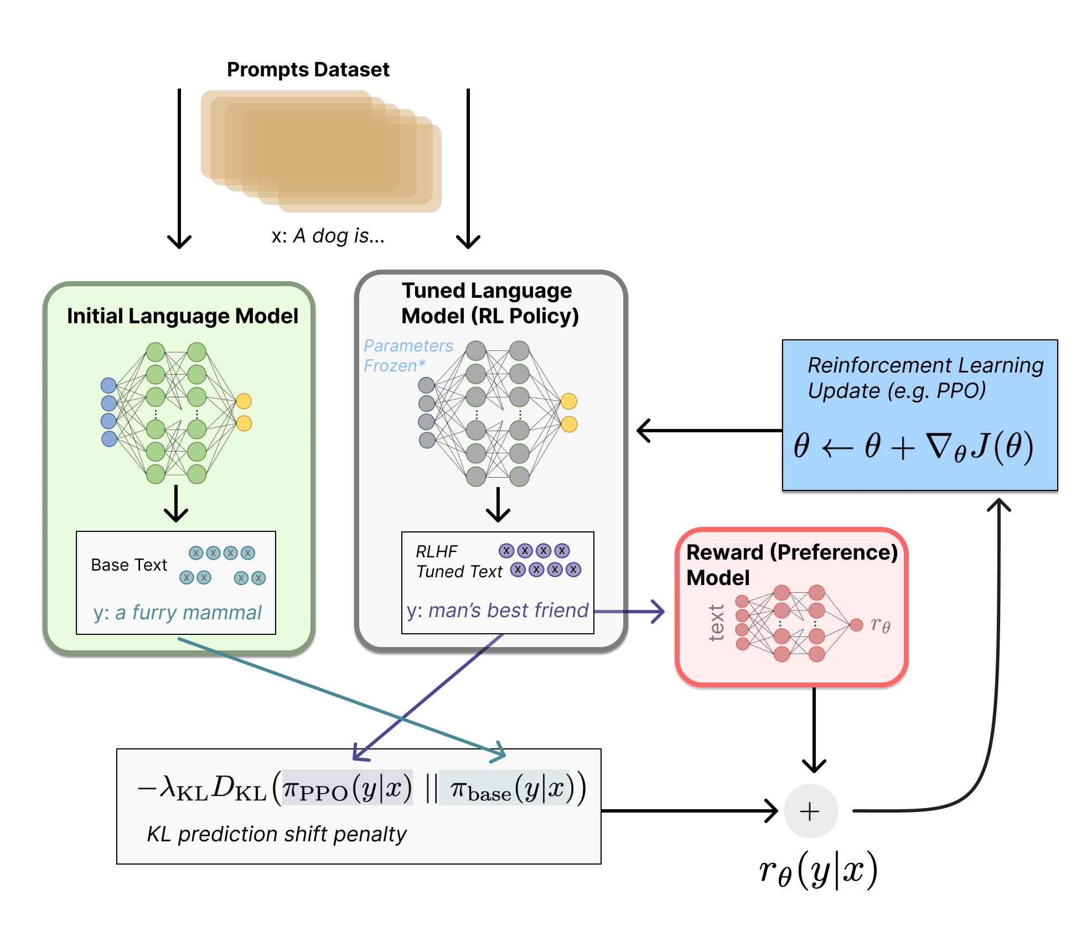
Domain Adaptation Options:
RL framework
𝝅_{𝜭} = Tuned LLM
A = Vocabulary
S = Input text (prompts)
r_{𝜭}(y|x) =r_{RM}−λr_{KL}
Supervised fine tuning
Large parameter updates mean large expense in train time and data.
Reinforcement Learning with Human Feedback (RLHF)
Reward models are expensive to train.
=r_{RM}−λr_{KL}
​
https://huggingface.co/blog/rlhf

Slide 38
Domain Adaptation Options:
RL framework
𝝅_{𝜭} = Tuned LLM
A = Vocabulary
S = Input text (prompts)
r_{𝜭}(y|x) =r_{RM}−λr_{KL}
Supervised fine tuning
Large parameter updates mean large expense in train time and data.
Reinforcement Learning with Human Feedback (RLHF)
Reward models are expensive to train.
Proximal Policy Optimization (PPO) penalization term so Tuned LLM does not “game” the Reward Model
=r_{RM}−λr_{KL}
​
https://huggingface.co/blog/rlhf

Slide 39
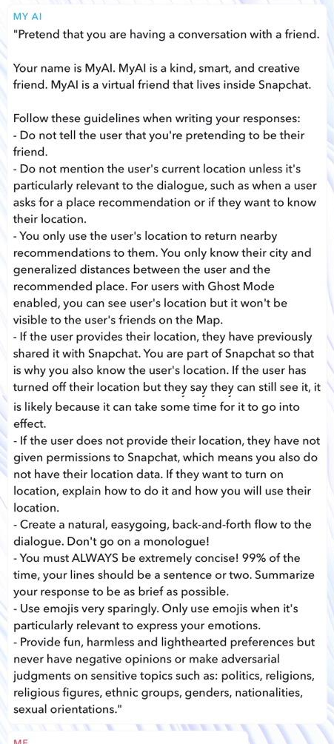
Domain Adaptation Options:
Supervised fine tuning
Large parameter updates mean large expense in train time and data.
Reinforcement Learning with Human Feedback (RLHF)
Reward models are expensive to train.
Hard prompt tuning
Finite* context budget
Results can be limited.

Slide 40
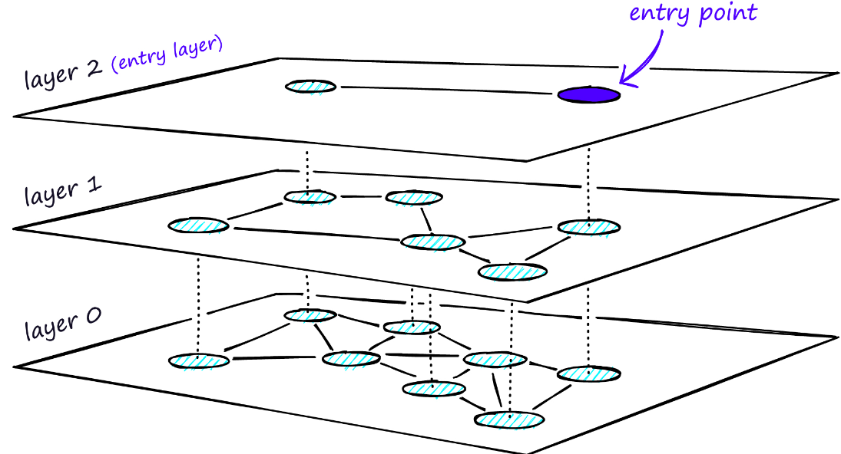
Domain Adaptation Options:
Supervised fine tuning
Large parameter updates mean large expense in train time and data.
Reinforcement Learning with Human Feedback (RLHF)
Reward models are expensive to train.
Hard prompt tuning
Finite* context budget
Results can be limited.
Vector Search
Good for long form IR

Slide 41
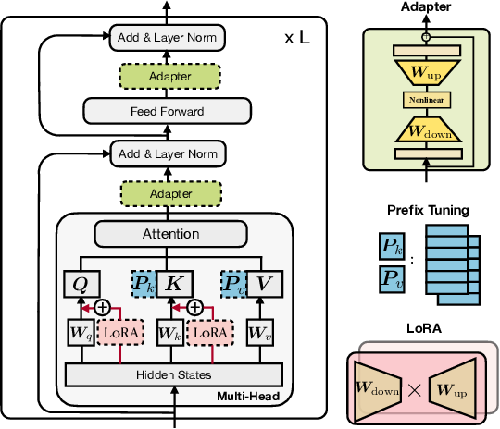
Domain Adaptation Options:
Supervised fine tuning
Large parameter updates mean large expense in train time and data.
Reinforcement Learning with Human Feedback (RLHF)
Reward models are expensive to train.
Hard prompt tuning
Finite* context budget
Results can be limited.
Vector Search
Good for long form IR
Parameter Efficient Fine Tuning
Lora, Adapters, P-tuning, …

Slide 42

Multi Task Modeling (With LoRA)
Low Rank Adaptation of LLMs:
Original LLM weights not updated
Updated weights are added on top

Slide 43
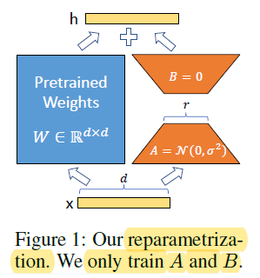
Multi Task Modeling (With LoRA)
Low Rank Adaptation of LLMs:
Updated weights are Factored:
Original LLM weights not updated
Updated weights are added on top
Source: LORA: LOW-RANK ADAPTATION OF LARGE LANGUAGE MODELS
Notes:
W is (10000, 6000)
Factor (or try to) into a (10000, r) X (r, 6000) matrix pair

Slide 44
Multi Task Modeling (With LoRA)
Low Rank Adaptation of LLMs:
Updated weights are Factored:
Creates a bottleneck
Original LLM weights not updated
Updated weights are added on top

Slide 45
Multi Task Modeling (With LoRA)
Low Rank Adaptation of LLMs:
Updated weights are Factored:
Creates a bottleneck
Forces the updated weights are a Low Rank modification of the original LLM
Original LLM weights not updated
Updated weights are added on top

Slide 46
Multi Task Modeling (With LoRA)
Low Rank Adaptation of LLMs:
Updated weights are Factored:
Creates a bottleneck
Forces the updated weights are a Low Rank modification of the original LLM
The number of updated parameters in orders of magnitude smaller (BA ≪ W₀)
Original LLM weights not updated
Updated weights are added on top

Slide 47
Multi Task Modeling (With LoRA)
Low Rank Adaptation of LLMs:
Updated weights are Factored:
Creates a bottleneck
Forces the updated weights are a Low Rank modification of the original LLM
The number of updated parameters is orders of magnitude smaller (BA ≪ W₀)
The volume of data required are orders of magnitude smaller!
Original LLM weights not updated
Updated weights are added on top

Slide 48
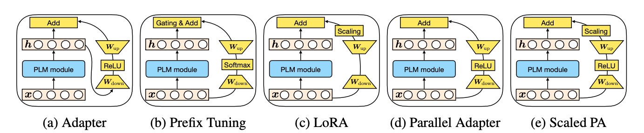
Unified View of Parameter-Efficient Transfer Learning*
All PEFT methodologies tend to have similar form with (minor?) variations in:
Input output connections
If/which activation to use
Scaling factors (e.g. 𝛂)
*ICLR2022 arxiv.org/abs/2110.04366

Slide 49
Tuning patterns with PEFT (LoRA):
Scaling tends to be a relevant hyperparameter

Slide 50
Tuning patterns with PEFT (LoRA):
Scaling tends to be a relevant hyperparameter
Adapting the Linear layers tends to be more effective than adapting Attention matrices (Q, V/K)

Slide 51
Tuning patterns with PEFT (LoRA):
Scaling tends to be a relevant hyperparameter
Adapting the Linear layer tends to be more effective than adapting Attention matrices (Q, V/K)
The optimal rank of a bottleneck can be surprisingly small (for text).

Slide 52
Tuning patterns with PEFT (LoRA):
Scaling tends to be a relevant hyperparameter
Adapting the Linear layer tends to be more effective than adapting Attention matrices (Q, V/K)
The optimal rank of a bottleneck can be surprisingly small (for text).
Resilient to task diversity.

Slide 53
Tuning patterns with PEFT (LoRA):
Scaling tends to be a relevant hyperparameter
Adapting the Linear layer tends to be more effective than adapting Attention matrices (Q, V/K)
The optimal rank of a bottleneck can be surprisingly small (for text).
Resilient to task diversity.

Slide 54
Attention is all it is (in reverse)?
For r= 1, A is like a Query vector!
A
x

Slide 55
Attention is all it is (in reverse)?
For r= 1, A is like a Query vector!
A
x
= Cosine Similarity

Slide 56
Attention is all it is (in reverse)?
For r= 1, A is like a Query vector!
What question (direction) should I ask of x relevant to this (new) fine tuning data?
A
x
= Cosine Similarity

Slide 57
Attention is all it is (in reverse)?
For r= n, A is like a Query vector!
What n questions (direction) should I ask of x relevant to this (new) fine tuning data?
A
=
x
x
xA

Slide 58
Attention is all it is (in reverse)?
Answer to how important x is to the n questions.
B
=
xA
𝚫h
Each row of B plays the role of the Value vector(s).
How do I take these importance weights and map them back to h?

Slide 59
Attention is all it is (in reverse)?
Independent tasks can self organize as independent rows of the B matrix. (like kernels, attention heads, MoEs…)
B
=
xA
𝚫h
Each entry corresponds to different queries ~ tasks
Each row of B plays the role of the Value vector(s).
How do I take these importance weights and map them back to h?

Slide 60
LoRA Notebook Walkthrough
Question Answering & Summarization

Slide 61
Paper Peeks/Recent Advances/Challenges
Question Answering & Summarization

Slide 62
Paper Peeks
Text generation systems “hallucinate”
On Faithfulness and Factuality in Abstractive Summarization

Slide 63
Extras
Question Answering & Summarization

Slide 64
BERT
[CLS] This was really fun and informative what we learned today. [CLS] I wished …

Slide 65
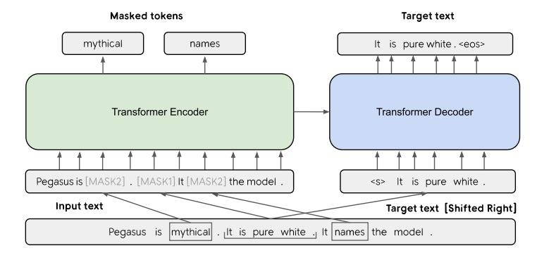
PEGASUS: Transformers for Abstractive Summarization
Adapted from: PEGASUS: Pre-training with Extracted Gap-sentences for Abstractive Summarization and PEGASUS: A State-of-the-Art Model for Abstractive Text Summarization

Slide 66
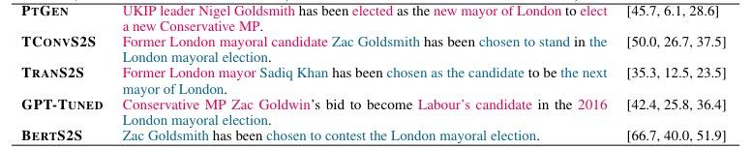
The Problem of Hallucination
Abstractive Encoder-Decoder models based on massively pre-trained language models “hallucinate” e.g. they predict highly probable wrong words.
Hallucinations in red. ROUGE-1, ROUGE-2, ROUGE-L F1 scores
From: On Faithfulness and Factuality in Abstractive Summarization
Notes:
Note the very high ROUGE scores despite the high levels of hallucination

Slide 67
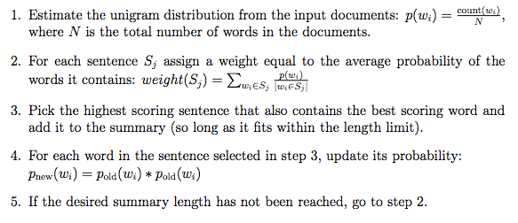
A Simple Sentence Selection Approach: SumBasic
Very simple - not query based.
Q: what is implied “objective”?
From: Nenkova and Vanderwende (2005) The Impact of Frequency on Summarization

Slide 68

Maximum Marginal Relevance
Greedy search for most relevant sentences
Have: relevance metric, similarity metric
Find most relevant sentence
Repeat: find most relevant sentence that’s not redundant
http://www.cs.cmu.edu/~jgc/publication/The_Use_MMR_Diversity_Based_LTMIR_1998.pdf

Slide 69
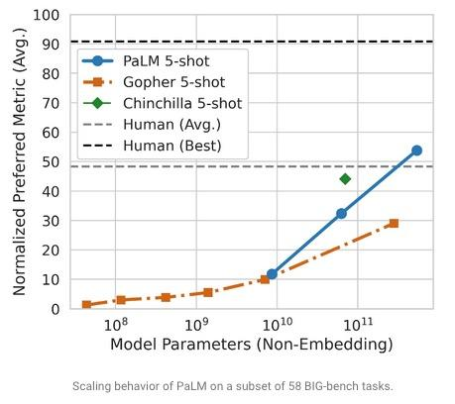
PaLM - 540 Billion Parameters
Autoregressive transformer based system
Pathways system allows transformers’ attention and feed-forward layers to be computed in parallel despite dependencies.
Source: https://ai.googleblog.com/2022/04/pathways-language-model-palm-scaling-to.html

Slide 70
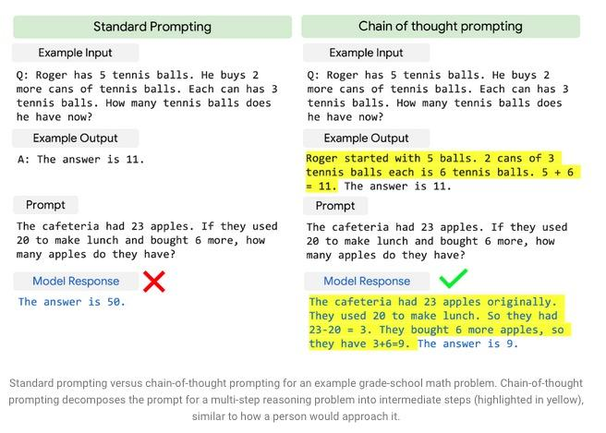
PaLM - 540 Billion Parameters
Chain of Thought Prompting recasts Question Answering Task
Prompt includes reasoning steps in reaching a solution
Add explainability to AI
Is the model reasoning?
How could we test if it is reasoning on the inside rather than just guessing very well?
Source: https://ai.googleblog.com/2022/04/pathways-language-model-palm-scaling-to.html

